Slide 1
Hotel booking analysis
CAPSTONE PROJECT
Presented By:
Wajeed Ahmed
University College of Engineering Kanchipuram
Mechanical department

Slide 2
OUTLINE
Problem Statement
Proposed System/Solution
System Development Approach
Algorithm & Deployment
Result
Conclusion
Future Scope
References

Slide 3
Problem Statement
To develop a comprehensive predictive model to determine the optimal timing for hotel room bookings, idendify the ideal length of stay for obtaining the best daily rates.

Slide 4
Proposed Solution
Utilizing advanced machine learning algorithms, our solution will analyze extensive historical hotel booking data.
The ideal length of stay will be determined through data-driven analysis, considering variables like day-of-week trends and duration-specific pricing.
For optimal timing, a predictive model will consider factors such seasonality and promotional periods, providing users with insights on when to secure the most cost-effective room rates.

Slide 5
System Approach
System requirements:
1. Hardware:
- A system with good processing power.
- Sufficient RAM to handle the size of the dataset and computational requirements.
2. Software:
- An operating system compatible with the required machine learning libraries.
Library requirements:
1.Data processing and analysis:
- Pandas : for data manipulation and analysis
- NumPy : for numerical operation
2. Data visualization :
- Matplotlib and Seaborn : for creating visualization to understand data patterns.

Slide 6
Algorithm & Deployment
Data exploration :
Explore the hotel booking dataset’s structure, features, and target variable.
Identify potential patters , correlations,and outliers.
Algorithm selection:
Regression tasks
Classification tasks
Problem formulation:
Define the problem: predict optimal booking times, ideal length of stay.

Slide 7
Algorithm & Deployment
Data collection:
Gather historical hotel booking data , including information on booking dates, length of stay, special requests, guest profiles and hotel details.
Data cleaning :
Handle missing values, outliers, and any inconsistencies in dataset.
Convert categorical variables into numerical representations through encoding techniques.

Slide 8
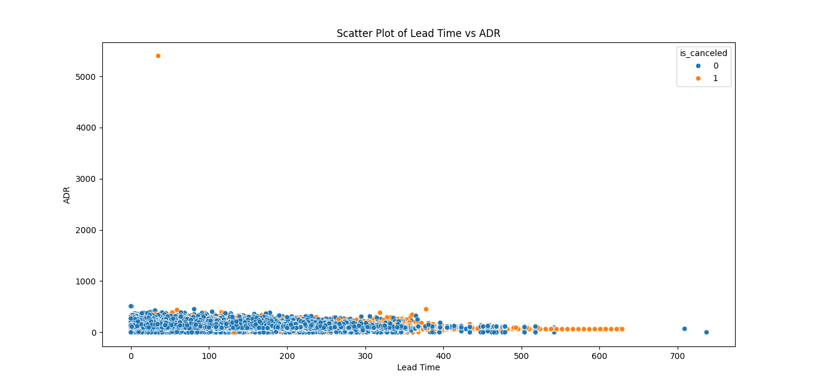
Result

Slide 9
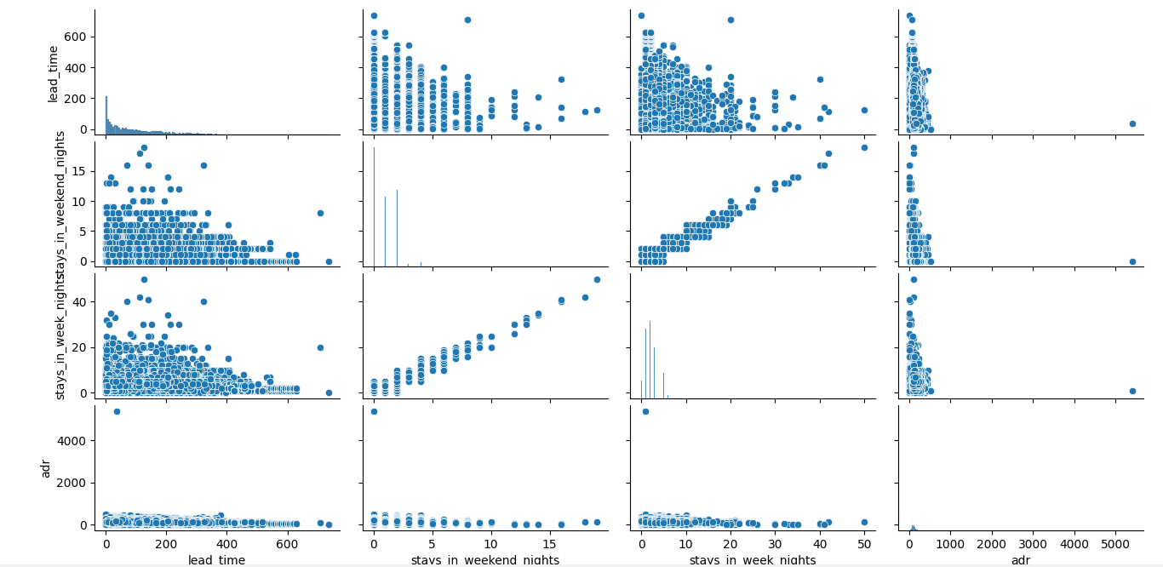
Result

Slide 10
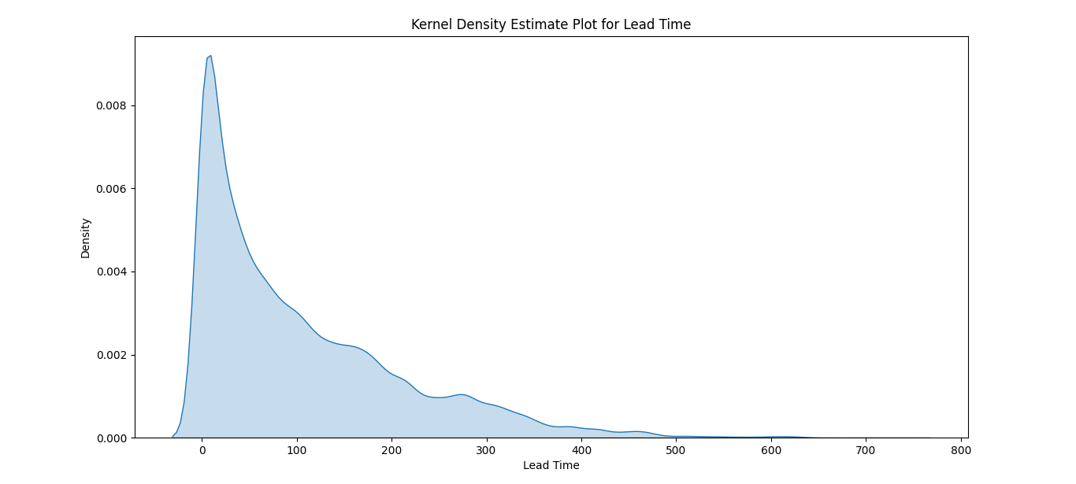
Result

Slide 11
Conclusion
In conclusion, the proposed solution harnesses the power of advanced machine learning algorithm to transform the hotel booking process into dynamic and optimized experience.

Slide 12
Future scope
Real-time predictions :
- Move towards real-time predictive models that account for instant changes in demand, external events and other dynamic factors .
Personalization and customization:
- Enhance the predictive models to offer more personalized recommendations by considering individual guest performances.

Slide 13
THANK YOU

